Slide 1
CRC Cards
Session 2 (Page 18 – 19)
UML Weekend Crash Course
Thomas A. Pender

Slide 2
CRC (Class, Responsibilities, and Collaborators)
CRC stands for Class, Responsibilities, and Collaborators.
Originally developed as a learning tool for making the transition to OO thinking.
The goal was to provide the simplest possible conceptual introduction to OO modeling.
A CRC card is a 3-x-5" or 4-x-6" lined index card.

Slide 3
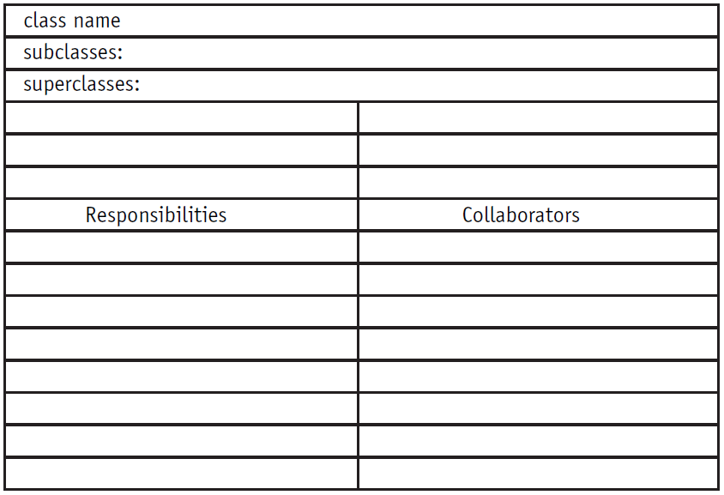
CRC Card

Slide 4
CRC Process
Requires people in two distinct roles: domain expert and object-oriented technology facilitator.
Domain experts provide knowledge of the subject area
OO facilitator coaches the team through the development of the cards and the eventual model.

Slide 5
CRC Process
1. Before the Scenario Execution
a. The Problem: Everyone agrees on the problem definition.
b. Brainstorming for Classes: Based on the problem statement, the team identifies candidate classes using the vocabulary of the problem.
c. Filtering Classes: The team works on definitions for each class, eliminating synonyms and conflicts.
d. Assigning Cards: Each team member is assigned responsibility for one or more classes.
2. The Scenario Execution
a. Each scenario expresses something that the system is supposed to do. The team walks through the scenario identifying the responsibilities of each class in the scenario.
b. Each discovered responsibility is recorded on the card of the corresponding class.

Slide 6
CRC Process
3. During the Scenario Execution
a. Grouping the Cards: The team identifies similar classes.
b. Scenario List: The team reviews the scenario coverage for completeness.
c. Collaboration Drawings: The cards are combined on a wall or white board to show how they cooperate in the execution of the scenarios.
4. After the Scenario Execution
a. The team reviews the resulting model and plans the implementation.

Slide 7
Sample CRC Cards
Class Name | Account
Description | Keeps track of owner, balance and transactions for each instance of customer’s bank account
Superclass
Subclass | Current Account, Saving Account
Responsibilities | Collaborators
Keep Track of Balance | Transaction
Update bank database | Database
Keep track of customer | Customer

Slide 8
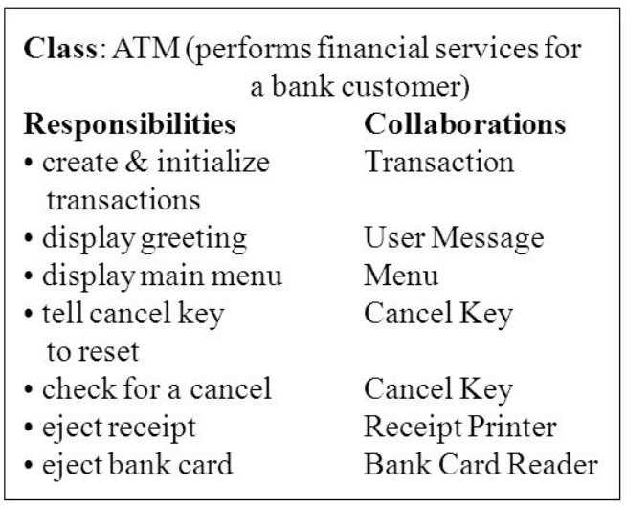
Sample CRC Cards

Slide 9
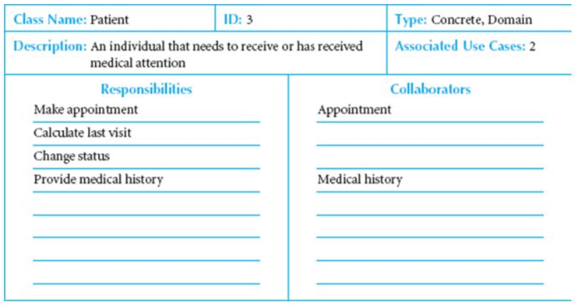
Sample CRC Cards

